Slide 1
Make Mars Green Again(GGOM)
Team Deep Bluu

Slide 2
Purpose
Show a more green future on our dear neighbor Mars
The game is supposed to be a fun and educational, to teach people about plant life in unnatural environment in an unique and fun way

Slide 3
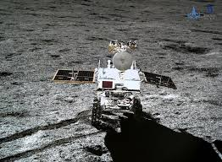
On the 3rd of January 2019 the Chinese mission “Chang’e 4” landed on the moon and tried to grow cotton, potatoes and thale cress, so maybe this imaginary future isn’t that far away

Slide 4
Our plans for the future
Add more flora
Add more educational parts
Add descriptions and facts about every plan
Add realism
More planets
Enable trading

Slide 5

What have we accomplished?
A cookie clicker
And a cactus :

